Slide 1

Find Best Place to Open a Cafe in Toronto Canada
Aswini Chinnenahalli SIDDAREDDY

Slide 2
Introduction
Toronto is capital city of the Ontario, Canada with a population of more than 6 Million
Toronto is international center for business, finance, arts, and culture, and is recognized as one of the most multicultural cities in the world
One of my friend is planning to open a Cafe business in Toronto, Canada region.
Finding a location is one of the most important things in starting a cafe.
The location search could take months if we start searching and analyzing the area manually.
We can reduce this time to few hours/ days by using machine learning techniques and Four-square location data to find best suitable location to open a Cafe.

Slide 3
Data Acquisition
Toronto data that contains Borough, Neighborhoods along with there latitudes and longitudes is obtained from https://en.wikipedia.org/wiki/List_of_postal_codes_of_Canada:_M
Geographical location of the neighborhoods is obtained from https://cocl.us/Geospatial_data
Venue Data is obtained using Foursquare API

Slide 4
Data Cleaning
Toronto data scraped from Wikipedia page has Boroughs that were not assigned to any neighborhood.
The following assumptions were made to clean the Toronto Wikipedia dataset.
- Only process the cells that have an assigned borough. Ignore cells with a borough that is Not assigned.
- More than one neighborhood can exist in one postal code area. For example, in the table on the Wikipedia page, you will notice that M5A is listed twice and has two neighborhoods: Harbourfront and Regent Park. These two rows will be combined into one row with the neighborhoods separated with a comma as shown in row 11 in the above table.
- If a cell has a borough but a Not assigned neighborhood, then the neighborhood will be the same as the borough.

Slide 5
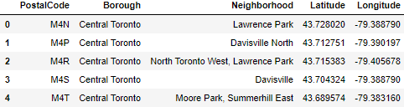
Data Cleaning
We merged the neighborhood dataset and geographical coordinates dataset into single dataset and the merged dataset is shown below.

Slide 6
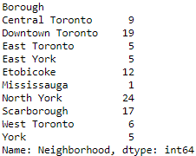
Exploratory Data Analysis
We have grouped the neighborhoods by borough and the count of neighborhoods by borough can be seen below.

Slide 7
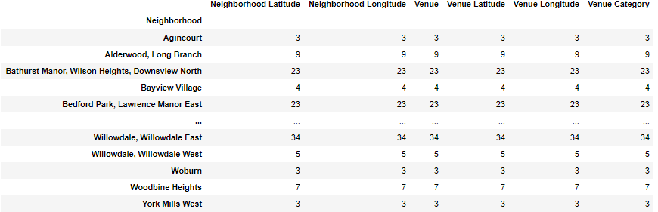
Exploratory Data Analysis
We then grouped the venues by neighborhood to see the total number of venues in each neighborhood.

Slide 8
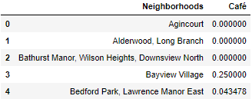
Exploratory Data Analysis
Group the data by neighborhood to see average number of Café’s present in each neighborhood.

Slide 9
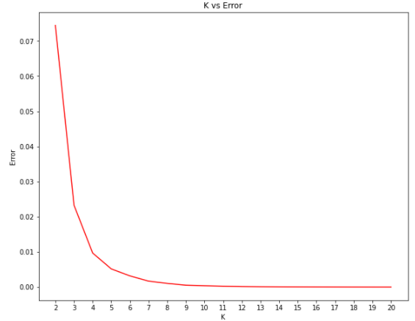
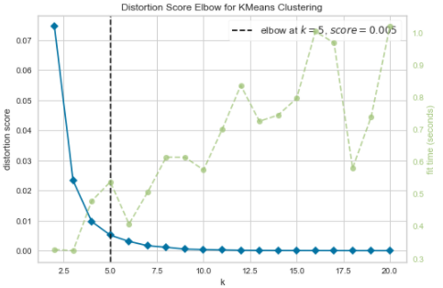
Exploratory Data Analysis
We have clustered the neighborhoods based on the similar number of cafés in that neighborhood using K-means clustering
We have used elbow technique to find the best k value that neither overfit nor under fits our model

Slide 10
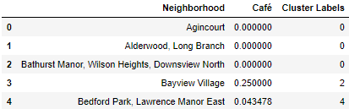
Exploratory Data Analysis
We will put the similar objects of a variable in the same cluster in k-means clustering.
The neighborhoods that has similar frequency of café’s were added to 5 clusters and are labelled from 0 to 4.

Slide 11
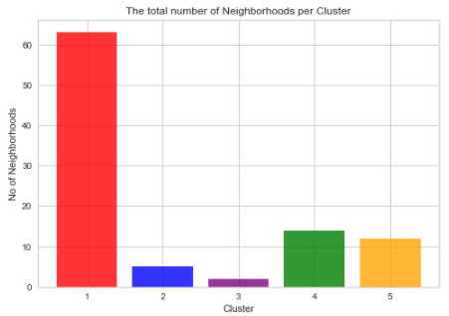
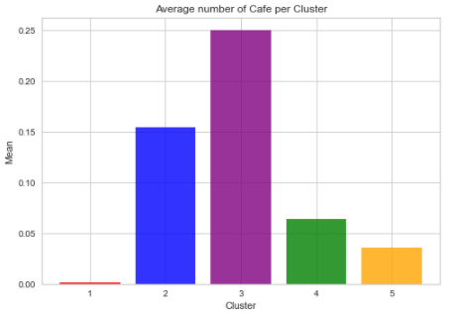
Analysis
We analyze the five clusters by finding the total number of neighborhoods in each cluster and average number of cafés in that cluster
We create a bar chart to see the total number of neighborhoods per cluster and average number of cafés per cluster

Slide 12
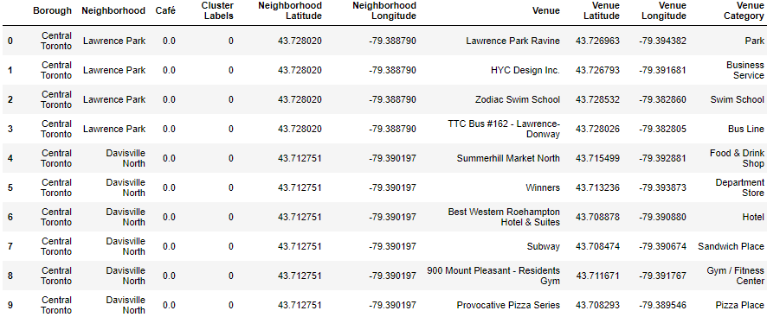
Analysis
Let us analyze the individual clusters by looking at their data frames.
Cluster 1:
We can see that cluster 1 is in Central Toronto area and it has 65 neighborhoods.
We have 22 unique venue locations in this cluster and there are very few cafés.
Cluster 1 has highest number of neighborhoods.

Slide 13
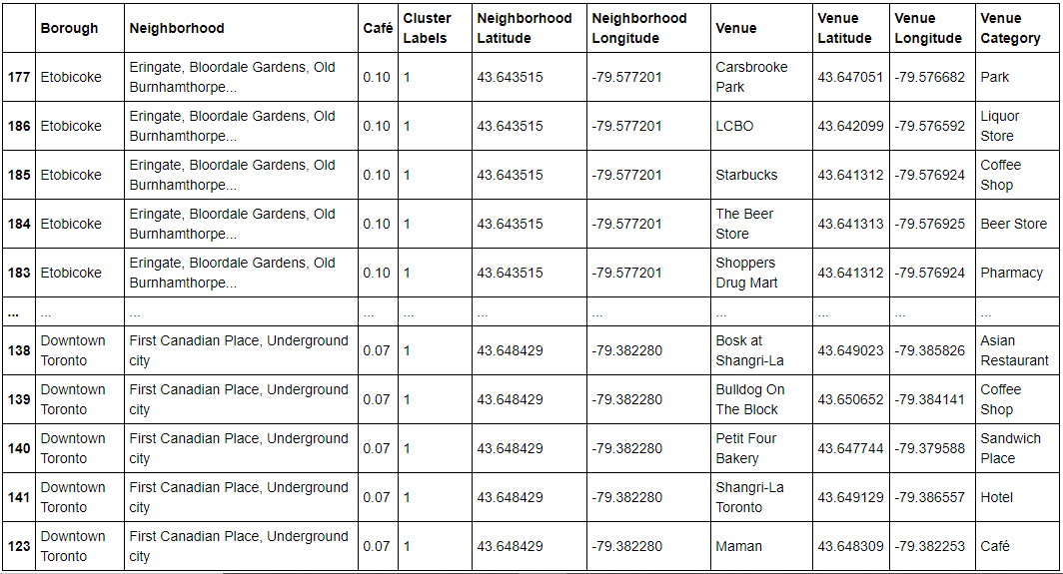
Analysis
Cluster 2:
We can see that cluster 2 is in Etobicoke, Downtown Toronto, etc. area and Erin gate, Bloor dale Gardens, Old Bumhamthrope, First Canadian Place, Underground city etc., are few neighborhoods in that cluster.
We have 19 unique venue locations in this cluster and there are a greater number of Cafés in this cluster when compared to cluster 1.

Slide 14
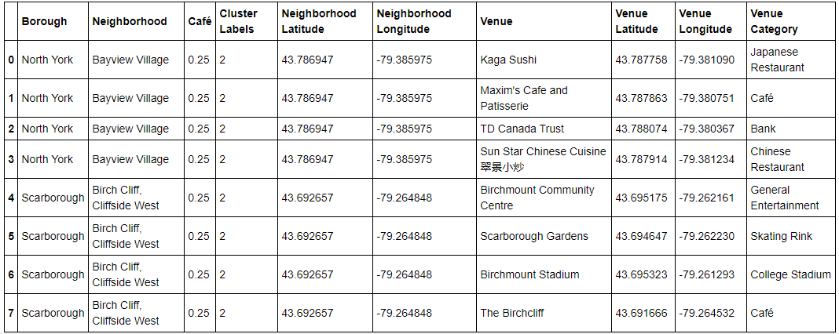
Analysis
Cluster 3:
We can see that cluster 3 is in North York, Scarborough area and Bayview Village, Birch Cliff, Cliffside West are few neighborhoods in that cluster.
We have 8 unique venue locations in this cluster and there are highest number of cafés in this cluster.

Slide 15
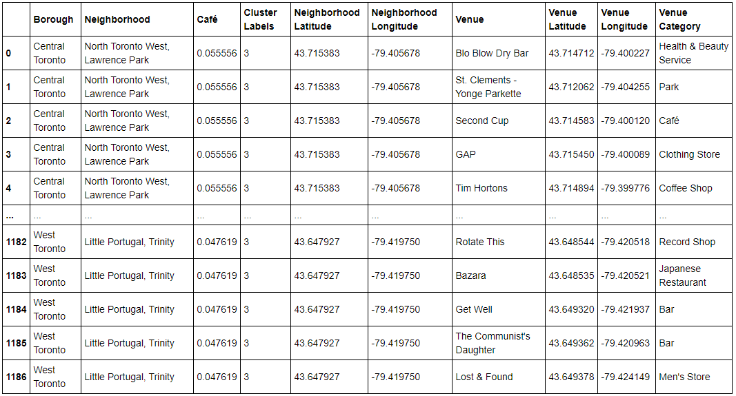
Analysis
Cluster 4:
We can see that cluster 4 is in Central Toronto, West Toronto area and North Toronto West, Lawrence Park, Little Portugal, Trinity are few neighborhoods in that cluster.
We have 56 unique venue locations in this cluster and there are only few cafés. Cluster 4 has third highest average for Café’s.

Slide 16
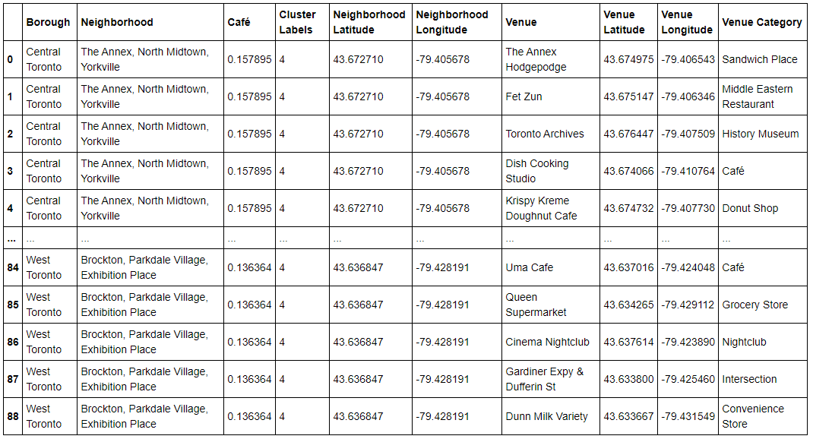
Analysis
Cluster 5:
We can see that cluster 5 is in Central Toronto and West Toronto area and The Annex, North Midtown, Yorkville are few neighborhoods in this cluster.
We have 26 unique venue locations in this cluster and there are very few cafés.

Slide 17
Conclusion and Future Directions
We have used several python libraries, Four Square API to find the best area to open a Café in Toronto, Canada
We created several visualizations to better understand our dataset and analysis using seaborn, matplotlib libraries
By using all these libraries, machine learning techniques, we are able say that the best place to open new café is Central Toronto area as there are many neighborhoods in that area and little to no cafés
In this study, we mainly focused on analyzing neighborhoods, venue details. However, population, other demographic details might also contribute to evaluate Café business success criteria.
By adding demographic data into analysis, we can increase the confidence and accuracy of our analysis in finding best place to open Café in Toronto.

